Slide 1


Mouse Stress Determination by Integral Analysis of Hippocampus Neuron Activities and Motor Behaviors
Donghan Liu

Slide 2
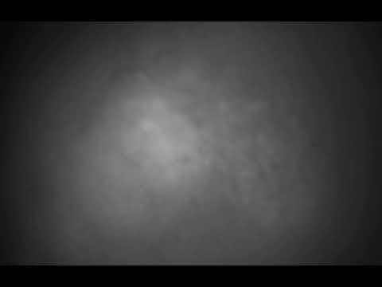
Neural Firing (mouse)
Definition:
Neural decoding refers to the process of transforming measured neural activity from its original, usually high-dimensional, domain of representation to a new domain that is typically of much lower dimension.
Collaborate with Dr. Tak Pan Wong and Douglas Mental Health Institute
15x speed, 50 secs, millisecond camera
Notes:
Here, neural decoding definition is relatively long but useful for understanding what it is.
One video that recorded by Dr. Wong in The Douglas Hospital Research Centre. It will be very fast, so pay attention
15x speed in 50 seconds video, and recored by a millisecond camera.

Slide 3
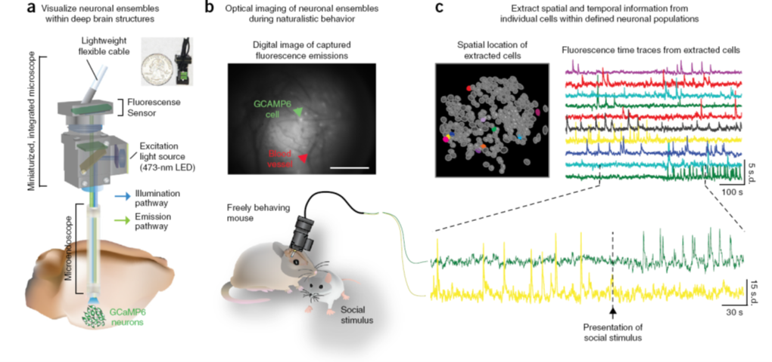
Experimental Settings

Slide 4
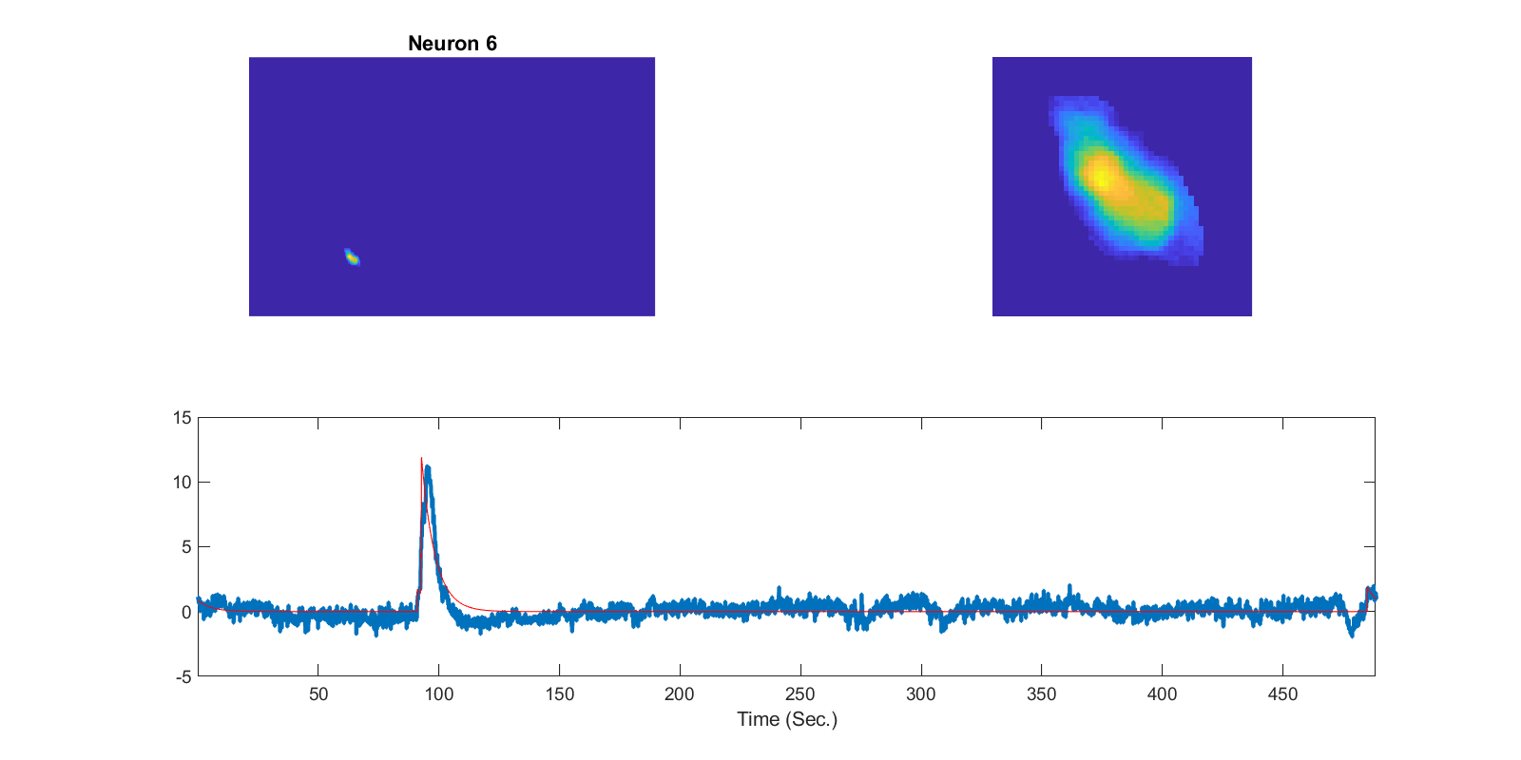
Single neuron spiking

Slide 5
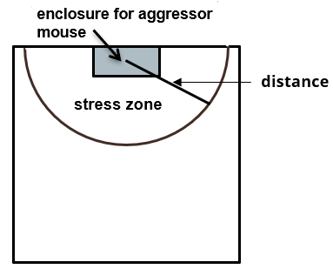
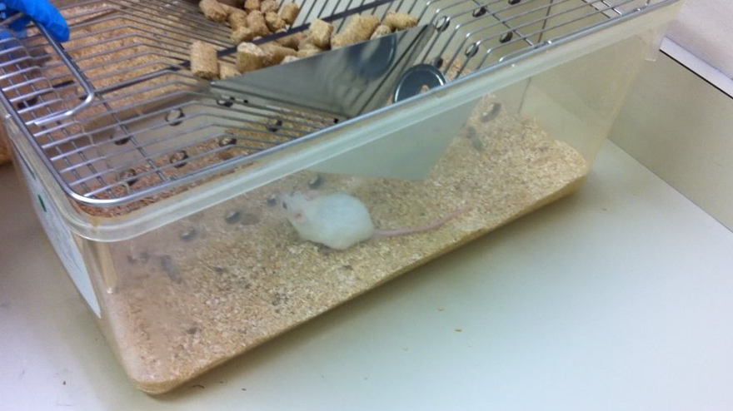
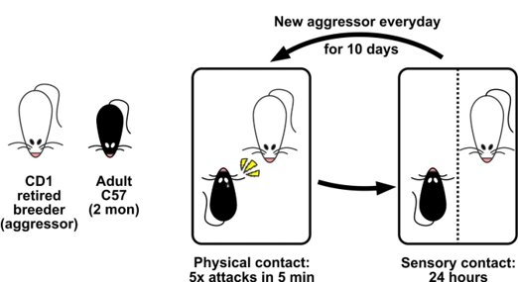

Stress Behavior

Slide 6
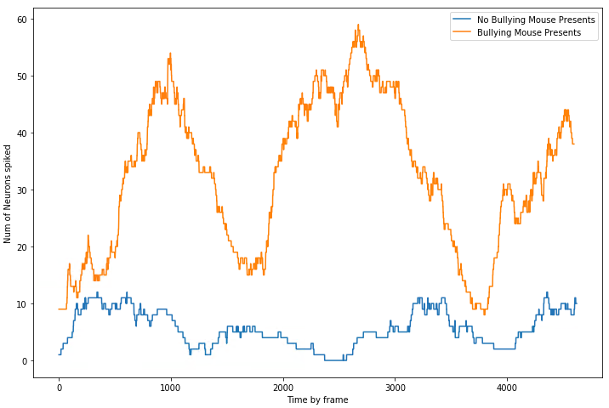
Stress Reflects to Neural Activities

Slide 7
Why?
Design a new drug to alter animal’s motor behavior
Design a new drug to alter animal’s neuron firing activities
More WHYs, why mouse, and why new drug ???
Mice are mammals, and also because they share a high degree of homology with humans, implies that their neuron structure have human homologs
Stress causes mental illness, such as depression and PTSD
New drug helps people with mental disorder
Notes:
So why would we care about the stress of the mouse?
The final goal is not to prevent mouse from being stressed, instead, we are aiming to study the relationship between stress and neuron activities and finally apply the findings to human body.
Drugs that designed

Slide 8
How?
Neural Decoding! In particular, Machine Learning! We need to determine which neurons are the cause of mental disorder and suppress them with certain measures.
Machine learning models will be trained by intake of a sequence of neuron activities, extracted and transformed to numerical values, and targeted to demonstrate if the mouse is “stressed” or “not stressed”, which will be defined by the mice distance
Notes:
Research problem and methods

Slide 9
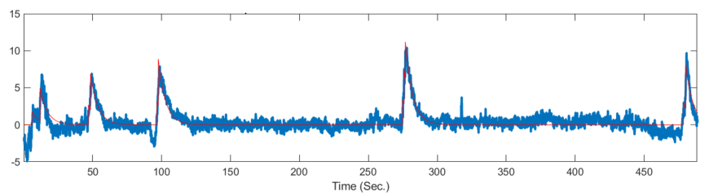
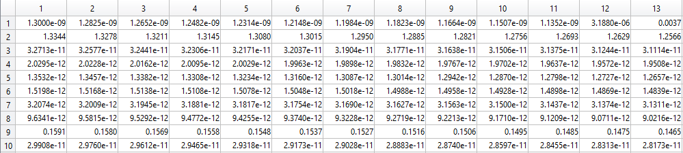
Data
One single rat:
Rows: ~300-400 neurons; Columns: ~9000-16000 time frame (~30 ms)

Slide 10
Procedures:
Distinguish the motor behavior to “stressing” or not by distance between defeated and bullying mice.
Feed them into our selected ML/DL models
Make the predictions
Link all neuron activities of each time frame to its corresponding mouse mental status: stressing or not

Slide 11
Models
Non-recurrent model:
Linear regression
Support vector regression
Feedforward neural networks.
Recurrent model: RNN (Recurrent neural network)
standard recurrent network,
a gated recurrent unit (GRU) network
a long short-term memory (LSTM) network

Slide 12
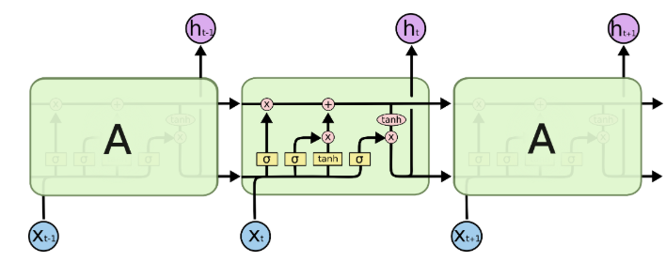
Example Decoder
Long-Short Term Memory
(LSTM): are a special type RNN, can learn long-term dependence
RNN: Typically, recurrent neural networks have short term memory in that they use persistent previous information to be used in the current neural network. Essentially, the previous information is used in the present task.
Weakness: Important information discarded in long-sequence
LSTM: a model or architecture that extends the memory of recurrent neural networks and using a structure founded on short-term memory processes to create longer-term memory. Forget/unlearn unimportant information so it controls which information will be kept and propagate forward. Each of current output state will be determined by both previous cell state and current state
Notes:
Memory: act as a transport highway that transfers relative information all the way down the sequence chain,
The cell state, in theory, can carry relevant information throughout the processing of the sequence, even information from the earlier time steps can make it’s way to later time steps, reducing the effects of short-term memory
Forget states: This gate decides what information should be thrown away or kept, by sigmoid function
Input gate: by passing the previous hidden state and current input into a sigmoid function. That decides which values will be updated by transforming the values
Output gate: The output gate decides what the next hidden state should be It will remember that the hidden state contains information on previous inputs

Slide 13
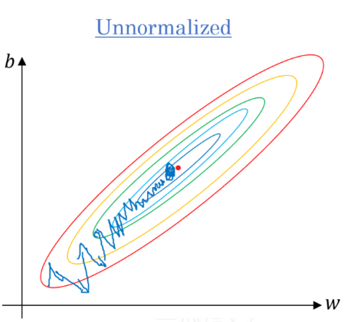
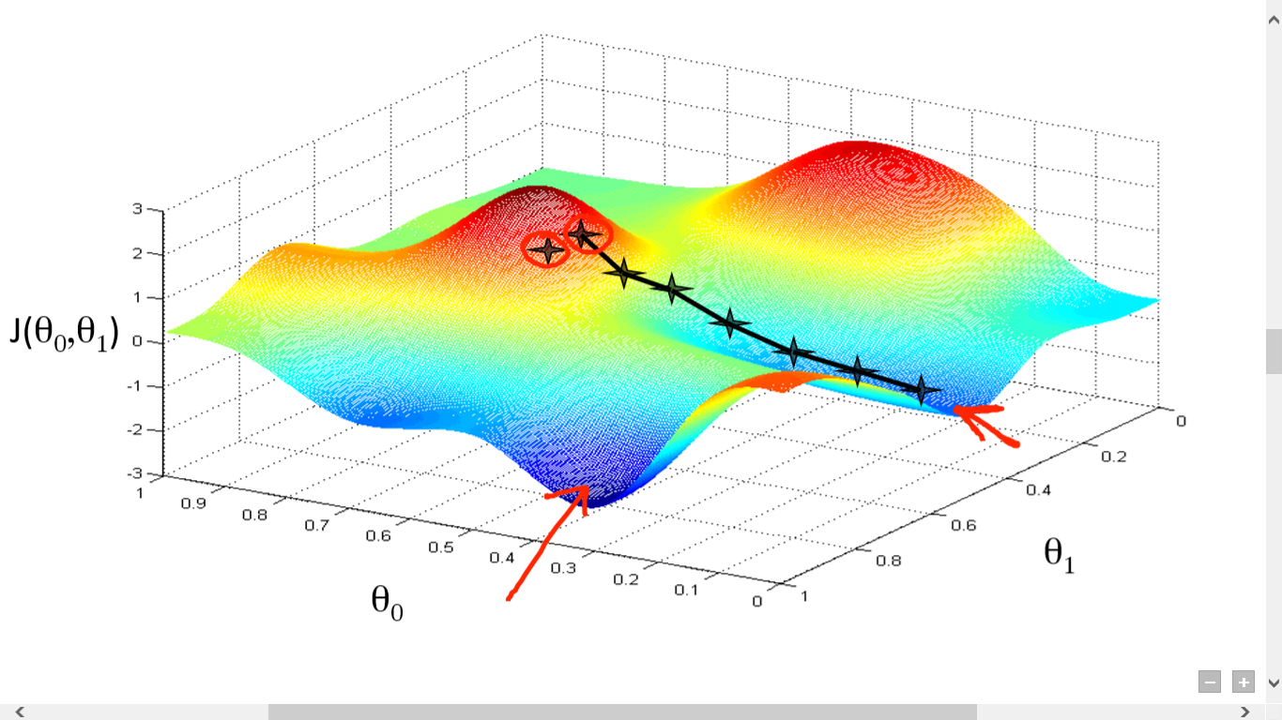
Pre-processing and Cross-Validation
Normalized (z-scored, zero-centered):
gradient descents can converge more quickly
CV:
a training set (80% of data),
a contiguous validation set (10% of data)
a contiguous testing set (10% of data)

Slide 14
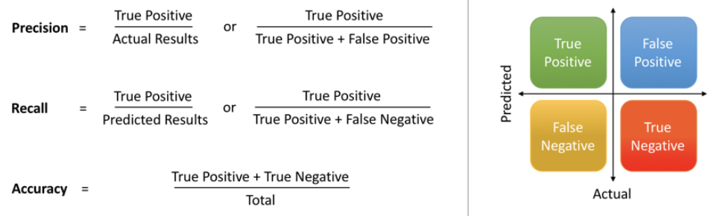
Scoring Metric

Slide 15
Results (Control Group)
 |  | Predicted
 |  | Not Stressed | Stressed
Real | Not Stressed | 2877 | 74
 | Stressed | 53 | 2368
Confusion Matrix
Classification Report:
Prediction Accuracy:
0.97617275
 | precision | recall | F1-score | support
Not Stressed | 0.97 | 0.98 | 0.97 | 2951
Stressed | 0.98 | 0.97 | 0.97 | 2421
Avg/total | 0.97 | 0.96 | 0.97 | 5372

Slide 16
Results (Experimental Group)
 |  | Predicted
 |  | Not Stressed | Stressed
Real | Not Stressed | 2856 | 76
 | Stressed | 59 | 1978
Confusion Matrix
Classification Report:
Prediction Accuracy:
0.9728
 | precision | recall | F1-score | support
Not Stressed | 0.97 | 0.98 | 0.97 | 2932
Stressed | 0.97 | 0.96 | 0.97 | 2037
Avg/total | 0.97 | 0.97 | 0.96 | 4969

Slide 17

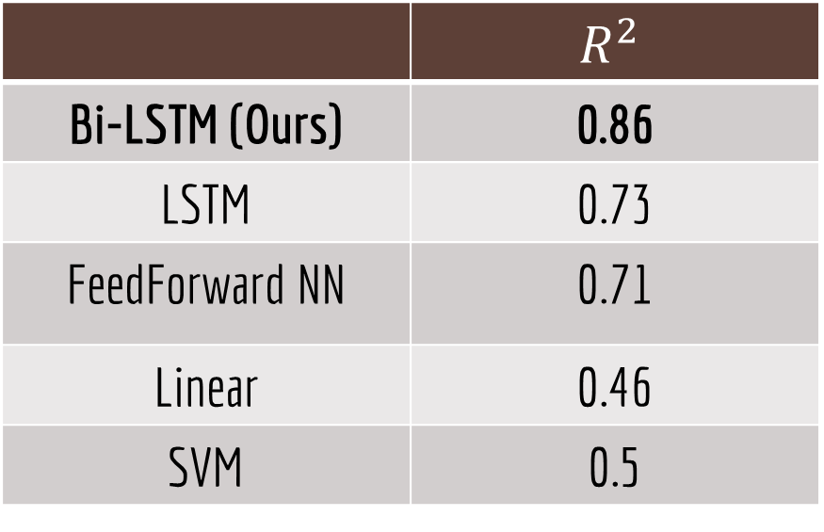
Contributions ($R^{2}$)
 | $$R^{2}$$
Bi-LSTM (Ours) | 0.86
LSTM | 0.73
FeedForward NN | 0.71
Linear | 0.46
SVM | 0.5
Notes:
Even though using machine learning in neuronscience is a common knowledge in the field, studying the stress and use the neuron activity to predict the motor activity is among the first to propose. So we convert our model prediction accuracy to R^2 in order to have a intuitive comparison with other researchers’ works.

Slide 18
Future Works
Construct the interpretable neural network to explain each neuron’s weight, so that we will have a basic sense of which neurons’ functions are supposed to restrain per the objective of avoiding or relieving mental disorder
Find the group of neurons that prompted the stress behavior

Slide 19
Thank you!

Slide 20
Reference
Glaser, J.I., Chowdhury, R.H., Perich, M.G., Miller, L.E., and Kording, K.P. (2017, August). Machine learning for neural decoding. Retrieved from Eprint arXiv:1708.00909.
StackPath, Retrieved from https://reconsider.news/2018/05/09/ai-researchers-allege-machine-learning-alchemy/
Wong, T. (2019). Hippocampal ensembles. Montreal, QC
Wong, T. (2019, March 19). Retrieved from https://www.youtube.com/watch?v=L-yz0WvWbNs
Wong, T. (2019, March 19). Retrieved from https://www.youtube.com/watch?v=60QKa9271ZM

